Slide 1

Hiring Process Analytics
Statistics
Project By: Sumit gope

Slide 2

Project Description
The project is about performing an exploratory data analysis (EDA) on a hiring dataset of a company. The goal is to extract insights from the data and provide recommendations to the hiring department. The project involves several steps, including understanding data columns, checking for missing data, clubbing columns with multiple categories, checking for outliers, drawing data summary, and creating charts and graphs to visualize the data.

Slide 3

Approach
The approach towards the project is to first understand the dataset and its columns. Then, the missing data is checked, and the required columns are clubbed together. Outliers are removed, and a data summary is created. Finally, different charts and graphs are created to visualize the data and extract insights from it.

Slide 4

Tech-Stack Used
The analysis was performed using Microsoft Excel. Excel was used because it has a wide range of statistical functions, charts, and graphs that can be used to perform EDA.

Slide 5
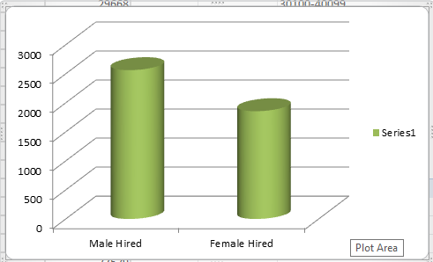
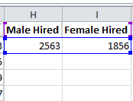
Insights
The analysis revealed several insights that can be useful for the hiring department. The key insights are summarized below:
Hiring: Process of intaking of people into an organization for different kinds of positions. Your task 1 : How many males and females are Hired ?
Solution:
First filter the data ‘Status’ colunm and ‘event_name’ then apply the formula for extracting the data of male hired and female hired separatly.
Formula: =SUBTOTAL(103,Range) or =SUBTOTAL(3,RANGE)
OUTPUT:

Slide 6

Average Salary: Adding all the salaries for a select group of employees and then dividing the sum by the number of employees in the group. Your task 2 : What is the average salary offered in this company ?
SOLUTION:
To find the average salary of the company we use the
average formula.
Formula: =AVERAGE(range)
Output:

Slide 7
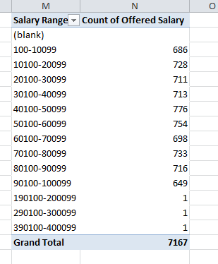
Class Intervals: The class interval is the difference between the upper class limit and the lower class limit. Your task 3 : Draw the class intervals for salary in the company ?
SOLUTION:
To solve this we use pivot table option, after clicking it the range bar open up to select range on which we want to derive class interval. After selecting range it shows all column on its field.
So, I drag “salary offered” column to the Row Labels field and also Value field. Then I put the difference for class interval.
Output:

Slide 8
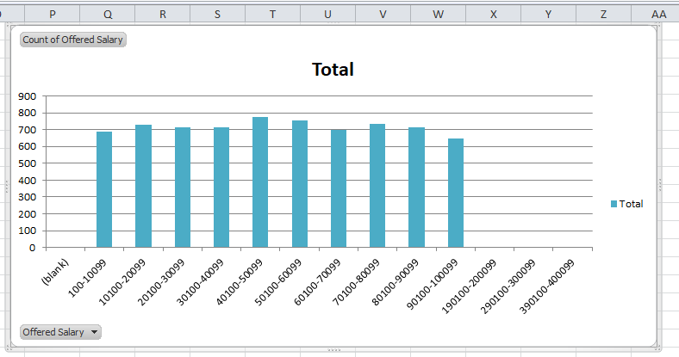

Slide 9
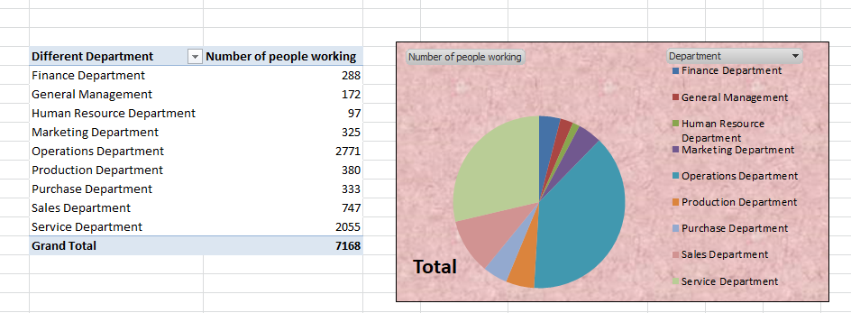
Charts and Plots: This is one of the most important part of analysis to visualize the data. Your task 4: Draw Pie Chart / Bar Graph ( or any other graph ) to show proportion of people working different department ?
SOLUTION:
To solve this again we use pivot table and process is same as 3rd task depending on column name.
Output:

Slide 10
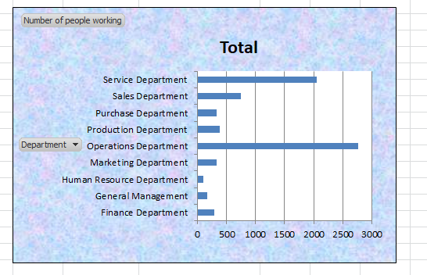

Slide 11
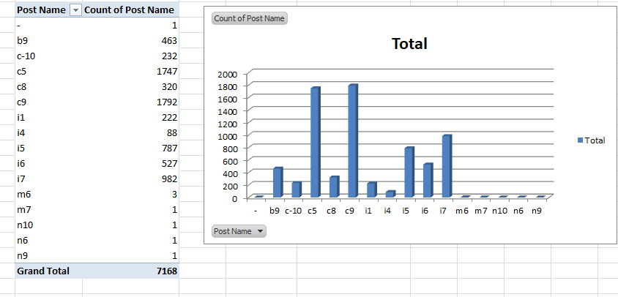
Charts: Use different charts and graphs to perform the task representing the data. Your task 5: Represent different post tiers using chart/graph?
SOLUTION:
To solve this again we use pivot table and process is same as above depending on column name.
Output:

Slide 12
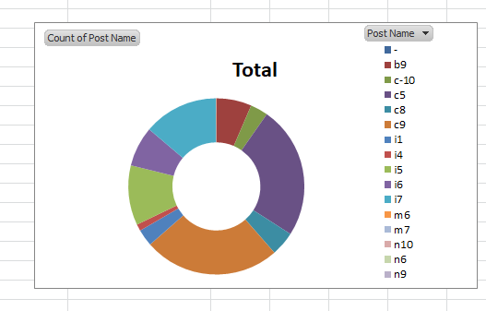

Slide 13
Result
The project has helped in gaining insights about the hiring process of the company. The analysis has provided valuable information that can be used to optimize the hiring process and make better hiring decisions.

Slide 14


